Slide 1
Why ODPi Egeria?
Open metadata and Governance

Slide 2
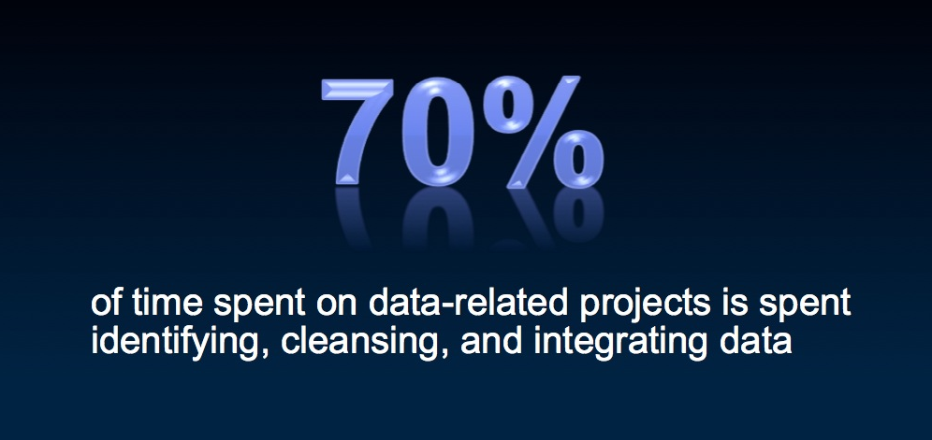
How can we become more effective with data?

Slide 3
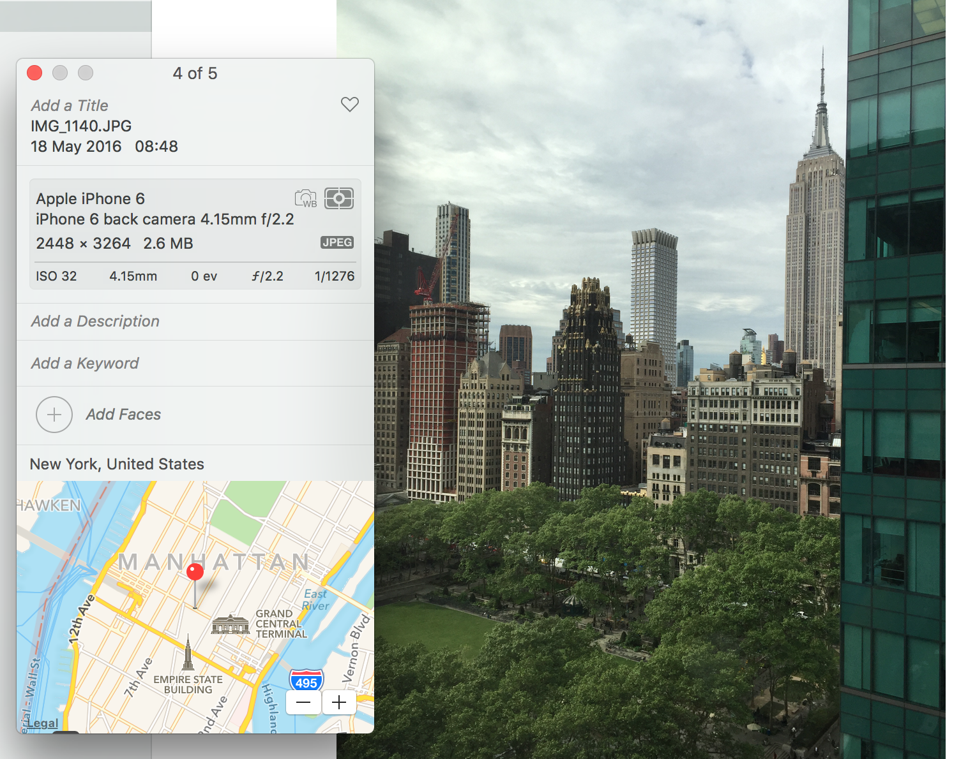
The value of open, standardized metadata
3
Notes:
AUTOMATED – Metadata is created by application at the same as the data is created in a standard manner easily consumable for all with necessary permissions
Device that took the picture / name of picture / settings picture was taken at / location geo tag of picture etc – all automatic – all done at creation of data time

Slide 4

Using a metadata repository to describe data
Metadata
Repository

Slide 5
Today’s reality – organizations buy lots of tools

Slide 6
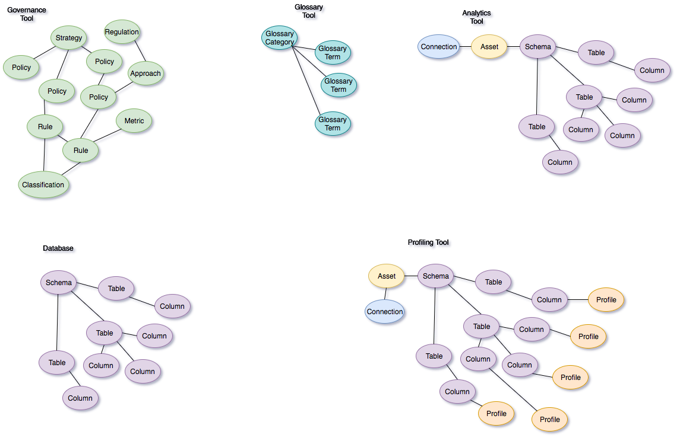

Slide 7
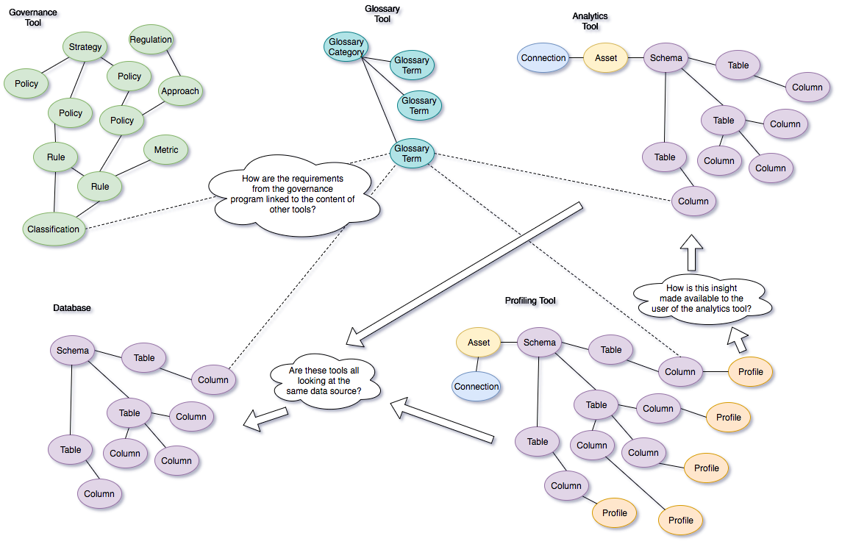

Slide 8
A new manifesto for metadata and governance
The maintenance of metadata must be automated to scale to the sheer volumes and variety of data involved in modern business. Similarly the use of metadata should be used to drive the governance of data and create a business friendly logical interface to the data landscape.
The availability of metadata management must become ubiquitous in cloud platforms and large data platforms, such as Apache Hadoop so that the processing engines on these platforms can rely on its availability and build capability around it.
Metadata access must become open and remotely accessible so that tools from different vendors can work with metadata located on different platforms. This implies unique identifiers for metadata elements, some level of standardization in the types and formats for metadata and standard interfaces for manipulating metadata.
Wherever possible, discovery and maintenance of metadata has to an integral part of all tools that access, change and move information.

Slide 9
ODPi Egeria enables exchange of metadata between tools from different vendors
Development
DevOps
Data Science
Open and
Unified Metadata

Slide 10
Egeria’s Distributed Virtual Graph
Uniting metadata from many tools

Slide 11
ODPi Egeria enables exchange of metadata between tools
Development
DevOps
Data Science
Open and
Unified Metadata
Notes:
Egeria is an Open Source framework that can be used to provide a distributed, unified view of metadata from different sources, including different stores and tools from different vendors.
Egeria creates a unified view of metadata residing in those tools and stores, so users can collaborate and share metadata, without needing to visit multiple tools or stores.
Egeria does not attempt to consolidate the metadata into one repository or tool – it’s better to leave it in place - the current owners stay in control of their metadata, and it stays local to its native store or tool.
Egeria provides an open type system, plus APIs, protocols, connectors and local metadata repositories.

Slide 12
Design philosophy
Use cases,
Personas,
Practitioners
input
Search
Open Metadata Access Services
Open Metadata Repository Services
Data integration, availability and integrity best practices
Notes:
The internal architecture of Egeria has two distinct layers.
The Open Metadata Access Services layer supports the different types of user and use case.
The Open Metadata Repository Services layer provides the unified view of metadata across distinct systems, using protocols and repositories for access and exchange of metadata objects.
Egeria’s OMRS layer includes the ability to refer to remote objects or replicate cached copies of remote objects for performance and availability
Egeria can store this distributed model in its own local repositories, which support the storing of:
local objects,
replicas of remote objects and
proxy-references to remote objects.

Slide 13
A Cohort of OMAG Servers
Search
Open Metadata
Access Services
Open Metadata
Access Services
Open Metadata
Access Services
Open Metadata
And Governance
(OMAG) Server
OMRS Cohort
Open Metadata Repository Services
Notes:
This slide shows a physical embodiment of a cohort of OMAG Servers.
An OMAG Server is a deployable unit of function and each OMAG Server can be configured to either run a set of OMAS services or support a repository, or a combination of these roles.
An Egeria cohort is a collection of cooperating OMAG Servers.
An OMAG Server may belong to multiple cohorts.
The OMAS services are local to a server
Each server runs the set of OMAS services listed in its configuration – it is OK to run 0, 1 or multiple OMAS services in a server
Each OMAS is for a specific purpose or persona
The OMRS protocol layer is supported by all servers
The OMAG Servers use OMRS to access/exchange metadata across the cohort
A server shares its metadata over OMRS – sending an event each time a change occurs, or sending a query to other servers
A server may optionally maintain a local Egeria repository
A server may optionally connect to a 3rd party metadata repository
In a few slides we’ll see that the OMRS itself is composed of distinct layers that focus on cross-cohort (“Enterprise”) functions and Local functions.

Slide 14
Egeria Open Metadata Repository Services (OMRS)
The OMRS defines a protocol and a set of connectors
The Enterprise Connector performs cohort-wide operations – this includes issuing queries to the cohort and when metadata is replicated from another server it can use the local connector and repository to cache it for availability and performance
The Local Connector performs local operations and provides a default Event Mapper that enables events relating to local operations to be sent to the cohort
The Repository Connector interfaces to a specific repository – and optionally, may be accompanied by a custom Event Mapper
Egeria provides two built in repositories and there are connectors to other repositories
The interface to a repository connector is the MetadataCollection API, described on the next slide
OMRS Enterprise Connector
Cohort
OMRS Local Connector
& Event Mapper
MetadataCollection
API
OMRS Repository Connector
Repository
Notes:
The role of OMRS is to provide a location transparent, unified view of metadata within a cohort.
Cross-cohort operations are supported by the OMRS ‘Enterprise Connector’, including sending queries to the cohort and receiving the results, as well as receiving replicated metadata and saving copies via the local connector.
Meanwhile the ‘Local Connector’ handles interactions with an (optional) local repository and provides a default event mapper that sends events when the local state changes.
The OMRS protocol uses publish/subscribe over Kafka topics, but the communication/messaging system is pluggable so different transports could be used.
The interface to the repository connector is the MetadataCollection API _ which is described on the next slide….

Slide 15
The OMRSMetadataCollection interface
The interface to an Egeria repository is the OMRSMetadataCollection interface
It includes groups of operations:
Group 1: Identification of metadata repository - metadataCollectionId
Group 2: Type definitions (types, attributes) - add, find, get, remove, …
Group 3: Find instances (entities, relationships) - get, find, graph-queries, …
Group 4: Maintain instances (entities, relationships) - addEntity, deleteEntity, …
Group 5: Change control information (entities, relationships) - reIdentify, reHome, …
Group 6: Maintenance of reference (replica) copies – save, purge, refresh,…
Notes:
We’re not going to describe this interface in detail – but it’s worth being aware of it, especially as we’re going to talk later about the graph-queries in Group 3.

Slide 16
Egeria metadata – a distributed graph
The interconnected nature of metadata forms a graph
Business
metadata
IS-A
Employee
Sensitive
HAS-A
Work Location
HAS-A
HAS-A
Hourly Pay Rate
Manager
HAS-A
Compensation Plan
HAS-A
HAS-A
Job Title
IS-A
IS-A
Employee Name
Employee Id
Annual Salary
Structural
metadata for
a data store
EmpName
EmpNo
JobCode
Salary
Employee Record
Data
The distributed nature of Egeria leads to a distributed graph…
Notes:
Egeria’s model of metadata is graph-oriented, both at the business layer and beneath that in the structural metadata
Business metadata describes the data that the business needs, what it means and how it should be classified and protected.
Structural metadata describes how the data is actually stored and labelled in the data store.
The linkages within and between the business and technical metadata forms a graph, that can be used to switch between these two perspectives.
One of the built-in repositories in Egeria is a graph repository,; a natural fit for the metadata graph that also accommodates the distributed nature of OMRS.
The Egeria local graph repository is built on the open-source JanusGraph graph database.

Slide 17
Egeria distributed graph model
A pair of entities are stored in separate servers
Database
Column
Glossary Term
OMAG Server 1
OMAG Server 2
Entity
Entity

Slide 18
Egeria distributed graph model
One entity could be replicated to the other server, as a ‘reference copy’
The original Glossary Term on OMAG Server 2 is still the master
A relationship could be defined between the local DB column and the reference copy of the Glossary Term
Database
Column
Glossary Term
Glossary
Term
Meaning
OMAG Server 1
OMAG Server 2
Reference
Copy
Relationship

Slide 19
Egeria distributed graph model
Both entities could be replicated to a third server, as reference copies
The originals are still the masters
A relationship could be defined between the local reference copies
Database
Column
Glossary
Term
OMAG Server 1
OMAG Server 2
Database Column
Glossary
Term
Meaning
OMAG Server 3

Slide 20
Egeria distributed graph model
Instead of replication, the third server could relate the original entities using entity proxies
Database
Column
Glossary
Term
OMAG Server 1
OMAG Server 2
Entity
Proxy
Database
Column
Glossary
Term
Meaning
OMAG Server 3
Notes:
It may not always be practical to replicate an instance
There are 2 occasions where using a proxy is advantageous:
An OMAS wants to save a relationship in a repository and the replication has not happened yet (or the set up is such that replication of that type is not enabled).
2. The repository does not support the full entity type but does support proxies (all proxies have the same storage requirement).
A key point about the distributed graph is that whether the relationship refers to a replica entity or uses an entity proxy – it is location transparent.
The Enterprise OMRS layer can select which repository into which to save an instance – based on capability and proximity.

Slide 21

Egeria Local Graph Repository
The Egeria distribution includes a persistent repository and a non-persistent reposiutory
The persistent repository is a graph repository built on JanusGraph
JanusGraph is an open-source project, hosted by the Linux Foundation
http://janusgraph.org
http://github.com/janusgraph/janusgraph
The built-in graph repository provides an OMAG Server with a persistent metadata store and is built using Egeria’s ‘plugin’ pattern
The graph repository can store instances of metadata owned by the local server
It can also store reference copies of metadata instances replicated to the local server
It also supports relationship instances that refer to entity proxy instances
Notes:
Egeria provides a persistent graph repository
It’s built using JanusGraph and currently uses version 0.3.1
JanusGraph is an open source project hosted by the Linux Foundation that supports the Apache Tinkerpop 3.3 interface.
The Egeria graph repository is built using the Egeria ‘plugin’ repository pattern – in which the repository connector is both the connector and the implementation of the repository.
The graph repository supports instances originating locally, instances replicated from a remote server and proxy instances.

Slide 22
Anatomy of the local graph repository
OMAS – access services
OMRS Enterprise Connector
OMRS topics
out
OMRS Local Connector
& Event Mapper
in
OMRS Graph Connector
Cohort
Graph Repository
JanusGraph Management
Apache Tinkerpop
persistence
search
JanusGraph
OMAG Server
Notes:
This slide shows (some of) the layers within an OMAG Server.
We talked earlier about the access services and about the Enterprise Connector and Local Connectors within OMRS.
Now we want to focus on the relationship between the Egeria graph repository connector and repository implementation (both in aqua-blue) and the JanusGraph code (in green)
As far as possible the repository uses Apache Tinkerpop for graph operations. This is simply that – while we like JanusGraph – it is probably sensible to stay as far as possible with the Tinkerpop interface for possible future portability.
There are some aspects of interacting with a graph database that are inherently implementation-specific – things like the configuration (e.g. of backends), schema and indexing. For these types of interaction it is necessary to use the JanusGraph Management interface.

Slide 23
Graph Repository components
GraphOMRSRepositoryConnector - implements the open connector framework interface
GraphOMRSRepositoryConnectorProvider – implements the mechanism for brokering a connector
GraphOMRSMetadataCollection – top level interface supporting type and instance operations
GraphOMRSMetadataStore – implements the MetadataCollection using a graph database
GraphOMRSGraphFactory – creation, schema, indexing - encapsulates JanusGraph-specifics
Mappers – convert between OMRS objects and graph vertices and edges
GraphOMRSEntityMapper
GraphOMRSRelationshipMapper
GraphOMRSClassificationMapper
Plus various utility classes – error codes, audit logging, constants and utility methods
https://github.com/odpi/egeria/
See open-metadata-implementation/adapters/open-connectors/repository-services-connectors/
open-metadata-collection-store-connectors/graph-repository-connector

Slide 24
To use the Egeria Graph Repository
Configure the OMAG Server repository-mode = ‘local-graph-repository’
e.g. HTTP POST http://localhost:8080/open-metadata/admin-services/users/{username}/servers/{servermame}/local-repository/mode/local-graph-repository
Subsequently, start the OMRS instance in the server
e.g. HTTP POST http://localhost:8080/open-metadata/admin-services/users/{username}/servers/{servername}/instance
When OMRS starts, the graph repository auto-creates a JanusGraph database – including:
Persistence backend
Search backend
Graph schema
Search indexes
For now, the persistence backend is embedded Berkeley DB and the indexing backend is Lucene – further options could be added

Slide 25
Graph Schema
The MetadataCollection interface is the formal interface to an Egeria repository.
Whilst it is possible to look at the graph directly (e.g. using Gremlin console):
Please don’t rely on the schema – it is likely to evolve
Type data:
The Graph Repository does not store type definitions
It delegates all type operations to the Repository Content Manager
Instance data:
The Egeria Graph Repository stores instance data, using a JanusGraph schema that has:
vertices for entities and classifications
edges for relationships and classifiers
Notes:
Whilst you could look inside the graph for debugging or development – please don’t write code that relies on the schema as it is very likely to evolve
The graph does not contain type information – Egeria provides a repository helper that manages types.
The graph is used to store instance data - as described in mode detail on the following slides…

Slide 26
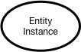
Instance representations in the OMRS
Notes:
Here is an example of a number of OMRS instance objects – there are two entities, that are connected by a relationship.
Also, one of the entities has two classifications.
All of the instances have attributes – some will be core attributes used for type or control information; others will be attributes that are specific to the instance type (known as type-defined attributes).
You don’t need to remember this picture – we’ll stick a copy of it in the top corner so we can refer back to it…..

Slide 27
Graph mapping – vertices and edges
Classification Instance
Entity Instance
Relationship Instance
OMRS instance
representation
Attributes
Attributes
Attributes
Primitives
Enums
Collections
Primitives
Enums
Collections
Primitives
Enums
Collections
label : “classification”
label : “entity”
label : “relationship”
label : “classifier”
Graph schema
element
vertex
vertex
edge
edge
Properties
Properties
Properties
Properties
Notes:
Entities and classifications are vertices.
Relationships and classifiers are edges.
The graph schema defines labels for Entity, Relationship, Classification and Classifier.
Vertex and edge properties are used to store OMRS instance data, which includes type, control and property information:
Type is referenced by name – not linked by an edge; types are held in the repository content manager, not stored in the graph
Control information is stored in ‘core attribute’ properties
Instance properties are stored in serialized form and under unique custom keys to support search

Slide 28
Graph mapping – vertices and edges
Properties
Properties
classification
classification
classifier
classifier
entity
Properties
Properties
relationship
entity
Properties
Notes:
Entities and classifications are vertices.
Relationships and classifiers are edges.
The graph schema defines labels for Entity, Relationship, Classification and Classifier.
Vertex and edge properties are used to store OMRS instance data, which includes type, control and property information:
Type is referenced by name – not linked by an edge; types are held in the repository content manager, not stored in the graph
Control information is stored in ‘core attribute’ properties
Instance properties are stored in serialized form and under unique custom keys to support search

Slide 29
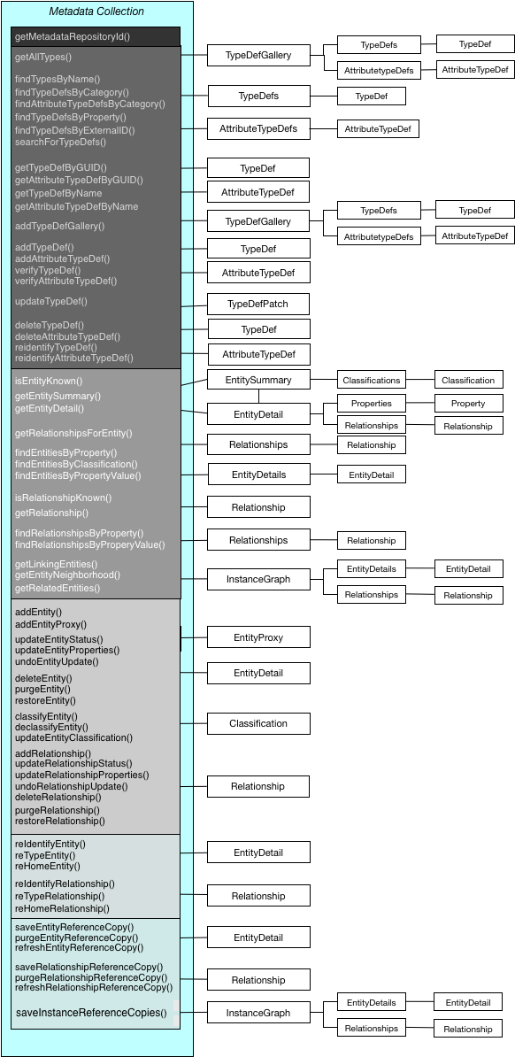
Metadata Repository API
A MetadataCollection supports a comprehensive API
Metadata collection Id
Query types
Define/maintain types
Search/query metadata instances
Maintain metadata instances
Historical (as of time) queries
Effectivity dating
Versioning
Metadata
Advanced maintenance
Managing reference copied
Protocol is forgiving – allowing minimal capability - metadata instance search/query

Slide 30
Local instances, reference copies and proxies
The graph contains one vertex per entity – whether the entity is local, a reference copy or a proxy
The graph contains one edge per relationship – whether the relationship is local or a reference copy
Reference Copies
The metadataCollectionId core attribute is set to the ‘guid’ of the home repository
Entity Proxy objects
Each entity instance has a vertex property of type Boolean, to indicate whether the instance is a proxy

Slide 31
The MetadataCollection ‘graph-query’ methods
There are 4 sub-graph query methods:
getRelatedEntities()
Returns the entity and its immediate neighbors
getEntityNeighborhood()
Returns the entity and its neighbors up to the depth specified by the ‘level’ parameter
getLinkingEntities()
Returns the relationships and intermediate entities that connect the specified pair of entities
getRelationshipsForEntity()
Returns relationships associated with entity, optionally filtered by relationship type and status
level = 2
Notes:
Within Group 3 of the MDC API ….

Slide 32
Graph Repository – supported functions
The GraphRepository supports most of the OMRS MetadataCollection API, including:
Save and purge of reference copies
Use of entity proxies
Delete and restore as well as purge – delete is a soft, restorable delete; purge is permanent
Re-type of instances
Re-identify of instances
Re-home of instances
The four ‘graph queries’ – described on the previous slide
The ‘find’ methods – find..ByProperty, find..ByPropertyValue, findEntityByClassification
The Graph Repository does not (yet) support:
Historic queries – find methods that specify an asOfTime parameter
Undo of previous instance updates

Slide 33


Further Information
Please visit us at Booth #53 on the 4th floor
Project website:
https://www.odpi.org/projects/egeria
Open source repositories:
http://github.com/odpi/egeria
http://github.com/janusgraph/janusgraph
33

Slide 34
Deployment Patterns
From large scale cloud services, on-premises local deployments to edge IoT devices

Slide 35
A hybrid multi-cloud world
Independent metadata Repository
New applications deployed to cloud
Mobile Apps
IoT devices and
systems
Business Partners
Sharing data
Linked metadata Repositories
Data Lake
Applications
Databases
Files
Applications

Slide 36
Open metadata ecosystem
Independent metadata Repository
New applications deployed to cloud
Mobile Apps
IoT devices and
systems
Business Partners
Sharing data
Linked metadata Repositories
Data Lake
Applications
Databases
Files
Applications

Slide 37
The OMAG Server Platform
OMAG Server Platform
OMAG Server Platform
OMAG Server Platform
OMAG Server Platform
Egeria Server 1
OMAG Server Platform
Multi-tenant
Egeria Server 1
Egeria Server 2
Egeria Server 2
Egeria Server 3
Egeria Server 3
Kubernetes
OMAG Server Platform
Egeria Server 1
Edge

Slide 38
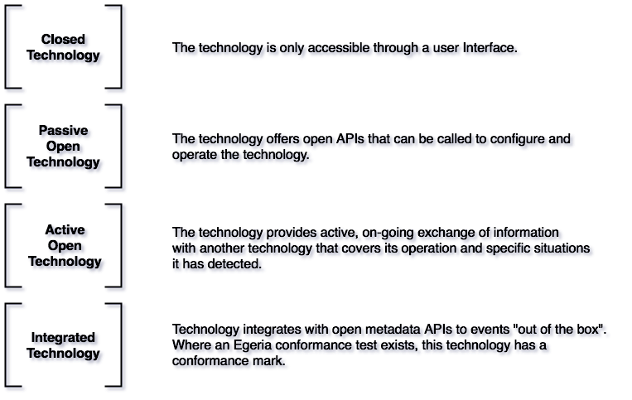
Metadata Tool Integration Patterns

Slide 39
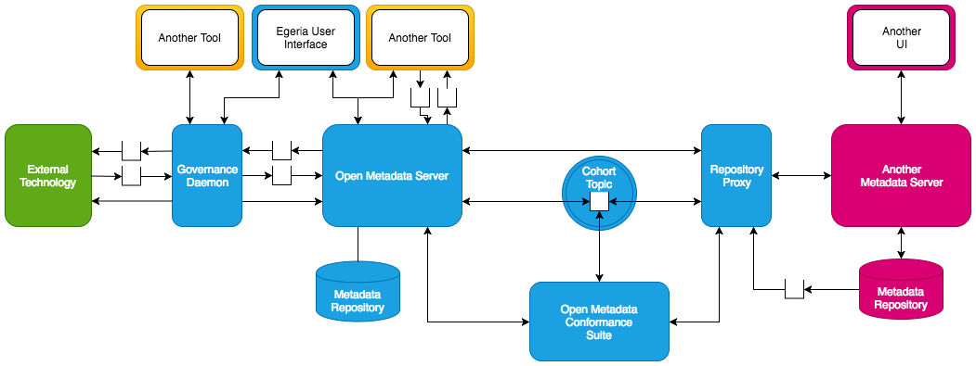
Metadata Tool Integration Patterns

Slide 40
Example of a simple cohort
Gaian
Virtualizer
Data Lake
Chief Data Office
Apache Ranger
Security-Sync
Cohort A
Stewardship
Data Bridge
Systems of Record
Stewardship
Stewardship
Data Onboarding

Slide 41
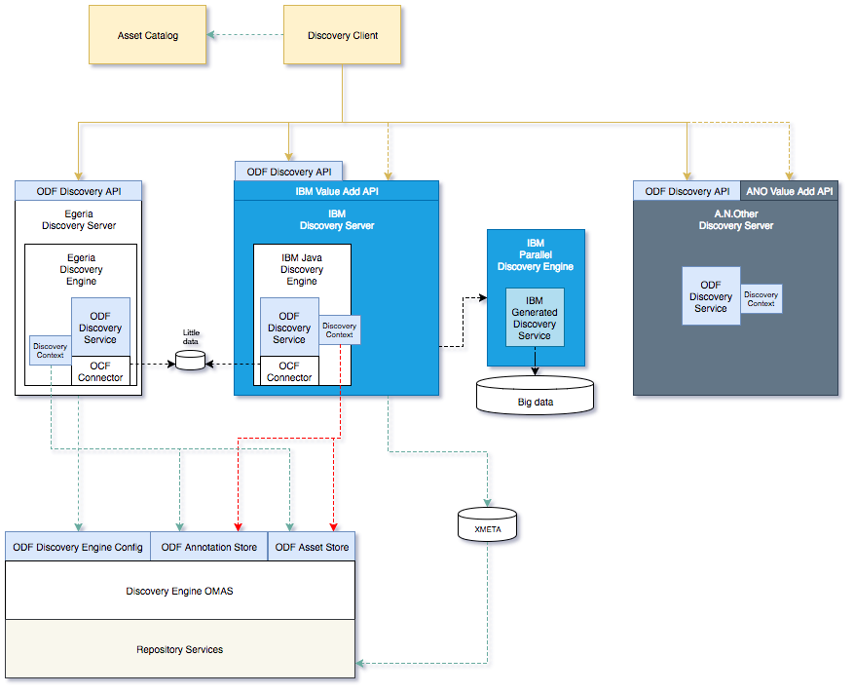
Metadata Tool Integration Patterns

Slide 42
User Interface Design
Supporting business and technical people

Slide 43



UI: good and the not so good.
Confusing
Presented for my role
Not my language
(too technical or not technical enough)
Logically flows to complete the
tasks I do.
Not meeting my needs
Underpinned by relevant
(persona specific) APIs
Not using my words
Someone from my role was involved
In creating the UI.
Mismatches my world view
Notes:
Experts in a field with their own jargon and ways of doing things.
Search report writer interested in assets and not security policies. Security policy author not interested in assets
Goals tasks associated artifacts for a role.

Slide 44
ODPi Egeria design
UIs
Use cases,
Personas,
Practitioners
input
Search
ODPi
Egeria
Open Metadata Access Services
Open Metadata Repository Services
Data integration, availability and integrity best practices
Metadata
repositories
44

Slide 45
ODPi Egeria UI types
Type 1
OMAS only
Type 2
OMAS and OCF
Connector
Type 3
OMRS
Type 4
Daemon UI
UIs
Search
Data
store
Open Metadata Access Services
Open Metadata Repository Services
Daemon
45
Notes:
1 OMAS only e,g Subject area, the UI only uses the OMAS interfaces to communicate with Egeria
2 OMAS and connector e.g. VDC metadata is obtained from Egeria using OMAs calls, the actual date is
accessed using an RDB connector
3 OMRS oriented UIs – e.g. Tex used to explore Egeria types
4 Daemon UIs – displaying Lineage

Slide 46
ODPi Egeria UI types work in progress
Type 1
OMAS only
Type 2
OMAS and OCF
Connector
Type 3
OMRS
Type 4
Daemon UI
UIs
Search
IBM creating
Subject Area UI
ING creating
Asset Search
IBM creating
Type explorer
and instance
explorer
ING creating
Lineage viewer
46
Notes:
1 OMAS only e,g Subject area, the UI only uses the OMAS interfaces to communicate with Egeria
2 OMAS and connector e.g. VDC metadata is obtained from Egeria using OMAs calls, the actual date is
accessed using an RDB connector
3 OMRS oriented UIs – e.g. Tex used to explore Egeria types
4 Daemon UIs – displaying Lineage

Slide 47
Current UI implementation
Tomcat *
configuration
Egeria
OMAG Server
Web app
Rest call
* Egeria Uis are coded to work with Tomcat. We expect other web servers will be used as the community
requires and implements.
Notes:
For this to work we need to know hostname and ports and url structures.
Configuration for tomcat is via application.properties
Configuration of the server is held in a file and authored via admin rest calls.

Slide 48
UI design – profile driven
Dealing well with potentially large amounts of data in a persona specific way is the challenge. E.g. by paging, limiting by neighborhood depth in graph calls
User’s roles defines what UI capabilities
a user should see
Subject area
Login
Personal
Profile
Type
explorer
Asset
Search
Many more to come ……..

Slide 49
Egeria UI technology experiences
Web component technology providing web components. It is not a framework
+ nice separation of components – hiding implementation in shadow dom
+ communicate with property binding
+ support for events
+ many existing paper and iron components for simple things.
David’s (Polymer newby) experiences:
- quirky – spent a lot of time finding the happy path to get things working, especially around web
components not being initialized when you want to use them (a big frustration was trying to issue a rest call
from the ready() method).
+/- need to be rigorous with architecture, it seems best to use one way bindings and events and
a top level controller component to drive state transitions for MVC e.g. around a grid. Redux may make
sense to hold state and define state transitions
- There is no free commercial smart (editable) grid I can find (this seems true for other frameworks as well)

Slide 50
The sort of architecture more complex web components require.
Controller controls all transitions
The model allows data updates to occur on
the model with simple CRUD operations
The model changes are then reflected into
the view.
Considerations:
Operations are currently synchronous. Redux
would be asynchronous
Spinner would need to lock across the complete
User interaction not just the rest call
Changes to the view made by the user and
changes to the view from the model, need to be
managed
- Paging required.
Notes:
Example here is the glossary grid. A grid for authoring glossaries in the subject area UI. Work in progress

Slide 51

Call for action!
Call to the community for open source UI developers!
Be part of showing how powerful open metadata is using visualization!
Fuel the ODPi rocket!

Slide 52
Community and Ecosystem
Building a strong community for the future.

Slide 53
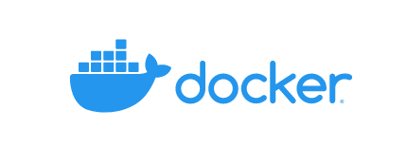


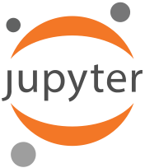
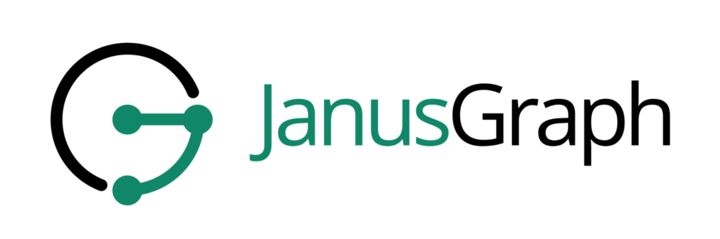
Open source dependencies
Spring Boot

Slide 54
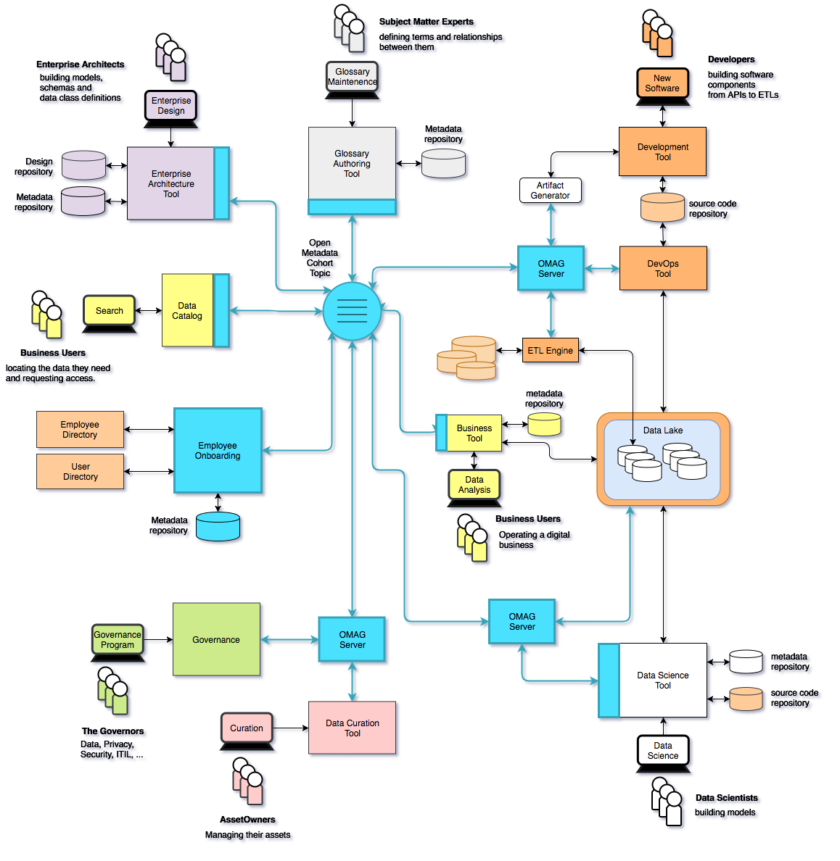
Using ODPi Egeria …
Eases the cost of metadata integration through
Comprehensive standards and libraries.
Active vendor recruitment program.
Provides direct support to many governance roles, filling the gaps between function offered through commercial tools.
Provides best practices and content packs to accelerate an organization’s journey to becoming data driven.

Slide 55
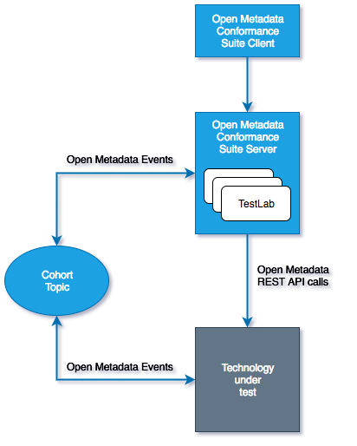
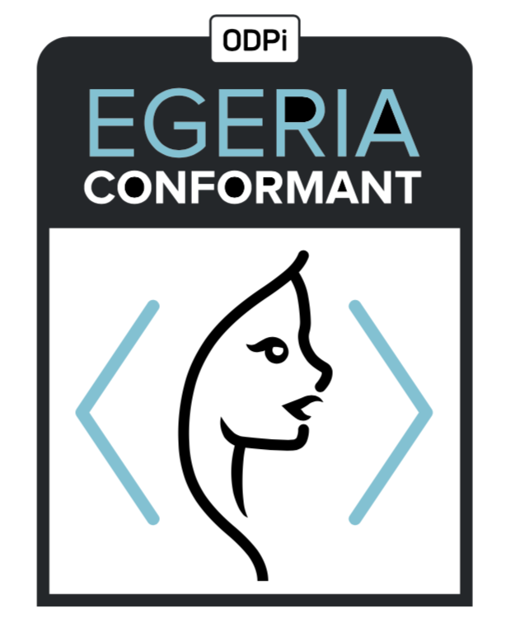
Egeria Conformance Program - its an “imitation game”
Workbench
Vendors that pass the conformance suite can display this mark
Notes:
ODPi

Slide 56
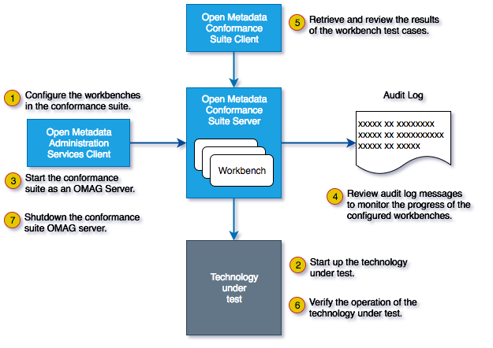
Running the Conformance Suite

Slide 57
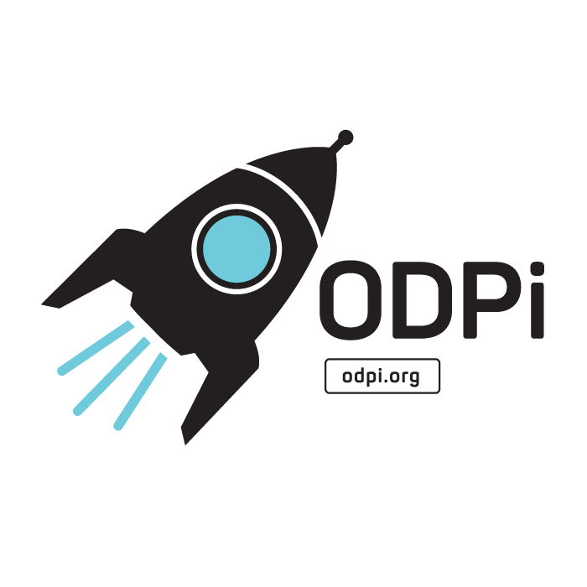


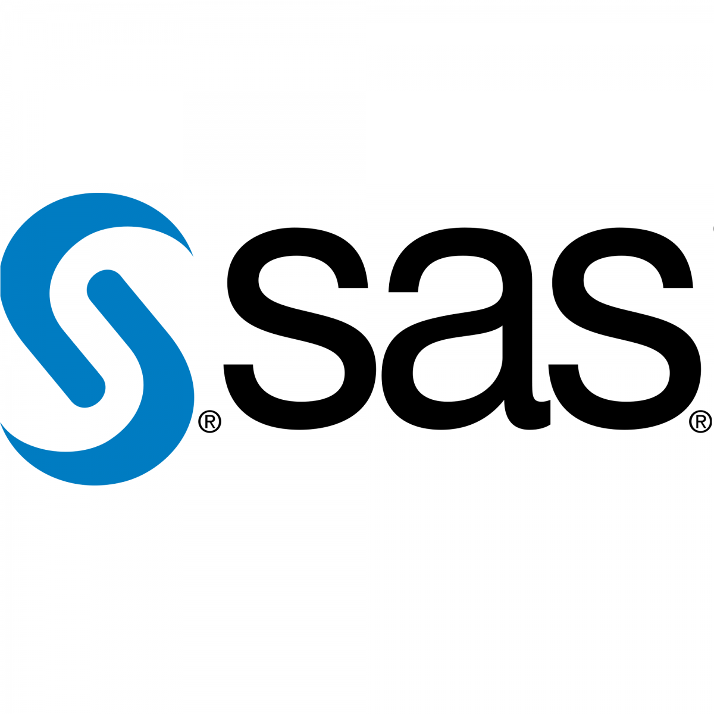

The ODPi is a non-profit that is part of The Linux Foundation
Delivering core technology
Recruiting vendors
Assisting practitioners
Core Technology
Vendors
Project
Egeria
Conformance Suite
Practitioners
Best Practices
Project
Data
Governance

Slide 58
Links
Press Releases and Podcast
Open source repositories
https://www.linuxfoundation.org/press-release/2018/08/odpi-announces-egeria-for-open-sharing-exchange-and-governance-of-metadata/
https://www.linuxfoundation.org/press-release/2019/02/odpi-announces-new-egeria-conformance-program-to-advance-open-metadata-exchange-between-vendor-tools/
https://roaringelephant.org/2018/09/25/episode-107-open-metadata-and-governance-masterclass-with-mandy-chessell-part-1/
https://roaringelephant.org/2018/10/09/episode-109-open-metadata-and-governance-
masterclass-with-mandy-chessell-part-2/
https://youtu.be/ryd3KFWT1mc
https://github.com/odpi/data-governance
https://github.com/odpi/egeria
58

Slide 59
Integrating with Partners
Working with different vendors

Slide 60
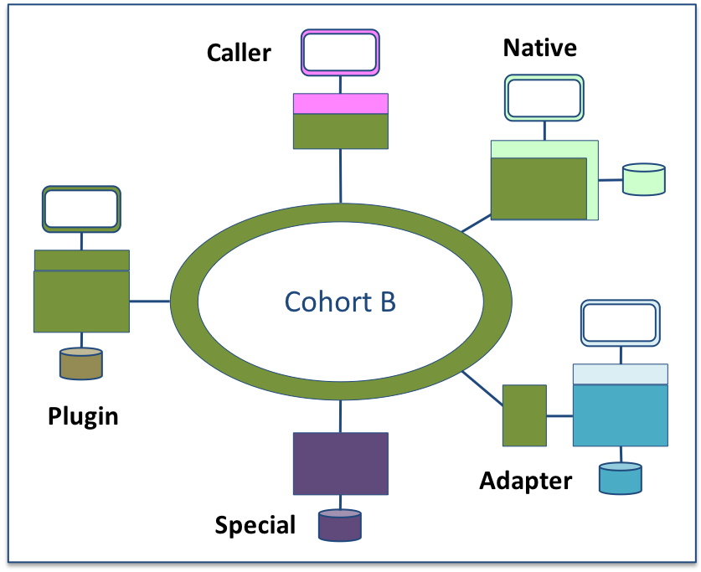
Metadata Repository Integration Patterns
Adapter
Native
Plug-in
Caller
Special

Slide 61
IBM Information Governance Catalog Integration
Egeria’s IGC integration uses the Adapter Pattern
There are two connectors to IGC running in the repository proxy server.
They translate IGC APIs and events into open metadata APIs and events.
Egeria handles the interaction with the cohort.
No need to upgrade IGC to adopt
Outbound metadata only
Repository Proxy
Information
Governance
Catalog
ODPi Egeria
Repository Connector
Event Mapper Connector
Open Metadata Highway

Slide 62

Apache Atlas Integration
The Egeria community is working on a similar integration for Apache Atlas.
Again there are two connectors in the repository proxy server.
These connectors translate Atlas APIs and events into open metadata APIs and events.
Egeria handles the interaction with the cohort.
No need to upgrade Atlas to adopt
Two-way exchange of native Atlas metadata
Repository Proxy
Apache Atlas
ODPi Egeria
Repository Connector
Event Mapper Connector
Open Metadata Highway

Slide 63
Native Integration
An alternative approach is the Native Pattern
There are still two connectors. They translate internal APIs and events into open metadata APIs and events.
ODPi Egeria handles the interaction with the cohort.
The connectors and the ODPi Egeria libraries reside in the metadata server.
No additional server; less network traffic; upgrade required.
ODPi Egeria
Metadata
Server
Repository Connector
Event Mapper Connector
Open Metadata Highway

Slide 64
Plug-in Integration
The plug-in pattern allows different repository back-ends to be plugged into the ODPi Egeria’s OMAG Server.
Egeria includes:
In-memory Repository (Testing and demos)
JanusGraph Repository (All scenarios)
Supports the full protocol and fills in the gaps left by the proprietary tools.
Open Metadata and Governance (OMAG)
Server
Repository Connector
Open Metadata Highway

Slide 65
Cohort Protocol
Server registration and metadata exchange

Slide 66
First server
The first server to join the cohort issues a registration request and waits for others to join.

Slide 67
Establishing contact
When another server joins the cohort they exchange registration information.

Slide 68
Federated queries
Once the registration is complete the cohort members can query each other.

Slide 69
Caching metadata for availability and performance
Metadata can also be replicated through the cohort

Slide 70
Open Metadata Types
What is the scope of open metadata?

Slide 71
Scope of metadata covered
Governance
Glossary
Collaboration
Models and
Reference Data
Lineage
Metadata
Discovery
Data Assets
Base Types, Systems
and Infrastructure

Slide 72
Scope of metadata covered
Strategy
4
Subject Area Definition
1
Teaming Metadata
(people profiles, communities, projects,
notebooks, …)
Policy Metadata (Principles, Regulations, Standards, Approaches, Rule Specifications, Roles and Metrics)
Business Objects and Relationships, Taxonomies and Ontologies
Augmentation
3
Organization
Feedback Metadata
(tags, comments, ratings, …)
Rollout
Classification
Business Attributes
Campaigns and Projects
Classification Schemes
Implementation
Mapping
Governance Actions and Processes
Rights
Management
Models and Schemas
2
Asset Collections
(Sets, Typed Sets, Type Organized Sets)
Reference Data
5
Instrument
7
Information Process
Instrumentation (design lineage)
Association
Information Views
Augmentation
Discovery
Metadata (profile data, technical classification, data classification,
data quality assessment, …)
Physical Asset Descriptions
(Data stores, APIs,
models and components)
0
Basic Types, Infrastructure and Systems
Access
6
Connectors

Slide 73
Using Design Thinking
Introducing Coco Pharmaceuticals

Slide 74
Design philosophy
Use cases,
Personas,
Practitioners
input
Search
Open Metadata Access Services
Open Metadata Repository Services
Data integration, availability and integrity best practices

Slide 75
Coco Pharmaceuticals persona
https://odpi.github.io/data-governance/coco-pharmaceuticals/personas/

Slide 76
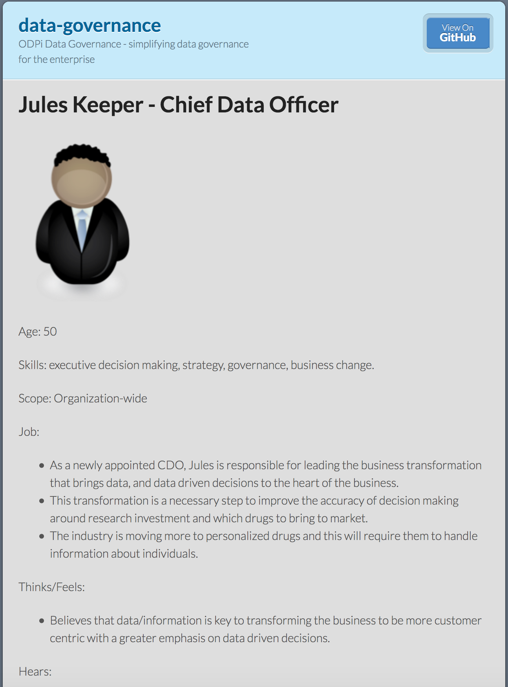
Using design thinking
Open Metadata Types
Access Service Identification
Samples and API design
Best Practices

Slide 77


Different personas need different services
Callie Quartile
Data Scientist
Find data
Understand data
Manage analytics models
Build data strategy
Define governance program
Monitor progress
Jules Keeper
Chief Data Officer

Slide 78


Different personas need different services
Tanya Tidie
Clinical Trials Administrator
Maintain accurate patient records
Catalog clinical trials data
Demonstrate good data management practices
Understand risks to organization
Set up protection
Monitor for suspicious activity
Ivor Padlock
Chief Security Officer

Slide 79


Event-driven governance
Assign
Owner
New
Database
Open
Metadata
Classify
Data
Use
Data

Slide 80
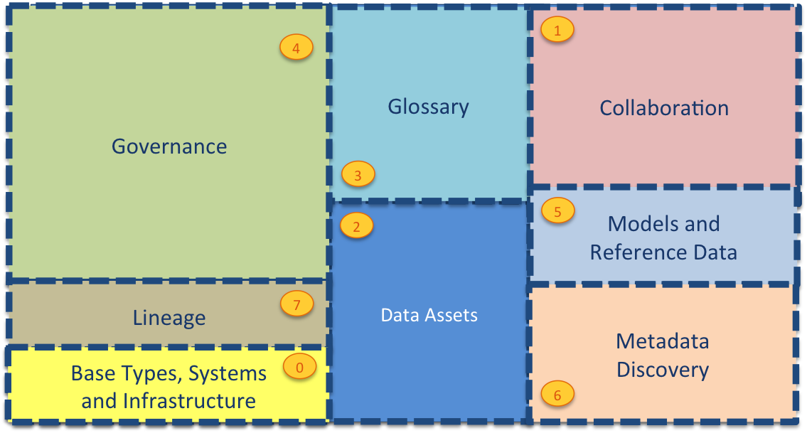
Current Open Metadata Access Services (OMASs)
Asset Consumer
Asset Owner
Asset Lineage
Subject Area
Asset Catalog
Community Profile
Stewardship Action
Project Management
Information View
Data Science
Governance Program
Software Developer
Data Privacy
Digital Architecture
Data Process
Data Protection
DevOps
Governance Engine
Data Infrastructure
Data Platform
Connected Asset
Discovery Engine

Slide 81
Open Metadata Access Service (OMAS) instance

Slide 82
Virtual Data Connector
Using metadata to control access to data

Slide 83

Automating governance example
Define Policies
Hadoop Metadata
Open
Governance APIs
Access
Data
IBM
Information
Governance
Catalog
Apache Atlas
Egeria
configure
Gaian
configure
Apache Ranger
Manage Data Access
Egeria Cohort
(Open metadata exchange and federated queries)

Slide 84
Scared to share (example)
Very Sensitive Data
Very Sensitive Data
Faith Broker
Human Resources
00 3809890 6 7 Lemmie Stage 818928 3082 4 New York 4 27 DataStage Expert 1 45324 300 27 Code St Harlem NY 1 3
00 3809890 3 7 Callie Quartile 328080 7432 5 New York 4 27 Data Scientist 1 56944 045 27 Code St Harlem NY 1 3
00 3809890 1 7 Tanya Tidie 209482 4051 2 New York 4 27 Data Steward 1 43800 215 27 Code St Harlem NY 1 3
00 3809890 6 7 Lemmie Stage 818928 3082 4 New York 4 27 DataStage Expert 1 ##### ### 27 Code St Harlem NY 1 3
00 3809890 3 7 Callie Quartile 328080 7432 5 New York 4 27 Data Scientist 1 ##### ### 27 Code St Harlem NY 1 3
00 3809890 1 7 Tanya Tidie 209482 4051 2 New York 4 27 Data Steward 1 ##### ### 27 Code St Harlem NY 1 3
Callie Quartile
Data Scientist

Slide 85
What does metadata look like?
Business
metadata
IS-A
Employee
Sensitive
HAS-A
Work Location
HAS-A
HAS-A
Hourly Pay Rate
Manager
Compensation Plan
HAS-A
IS-A
HAS-A
Job Title
IS-A
HAS-A
Employee Id
Annual Salary
Employee Name
Structural
metadata for
a data store
EmpName
EmpNo
JobCode
Salary
Employee Record
Data
00 3809890 6 7 Lemmie Stage 818928 3082 4 New York 4 27 DataStage Expert 1 45324 300 27 Code St Harlem NY 1 3
Notes:
Business metadata describes the data that the business needs, what it means and how it should be classified and protected.
Structural metadata describes how the data is actually stored and labelled in the data store.
The linkage between the business and technical metadata allows our technology to switch between these two perspectives. For example,
A request for data expressed in business terminology can be translated into a query for data from a data store.
An integration engine copying data into a sand box can discover which are the fields that the business classifies as sensitive and then mask these values dynamically.

Slide 86
Automating governance example
Define Policies
Hadoop Metadata
Open
Governance APIs
Access
Data
IBM
Information
Governance
Catalog
Apache Atlas
Egeria
configure
Gaian
configure
Apache Ranger
Manage Data Access
Egeria Cohort
(Open metadata exchange and federated queries)

Slide 87
Evolution of Governance
Egeria guidance on governance

Slide 88
Governance maturity seen in terms of Value and Scope

Slide 89
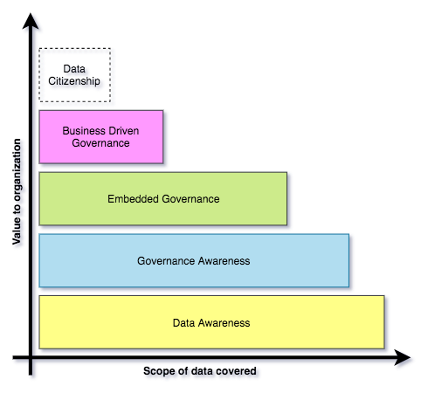
Building governance maturity is a gradual process
Organizations may operate different levels of maturity in different parts of their business.
Choices determined by where the most value lies.
Many organizations aspire to provide all employees with the data they need (data citizenship*)
https://opengovernance.odpi.org/maturity-model/

Slide 90
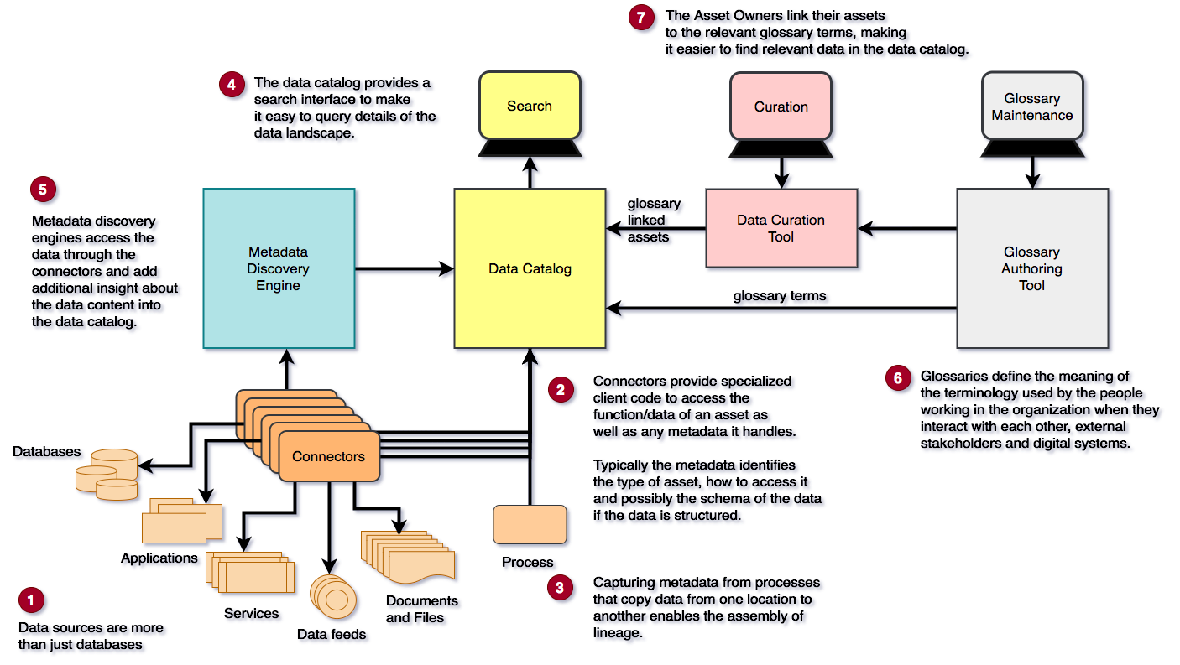
Implementing Data Awareness

Slide 91
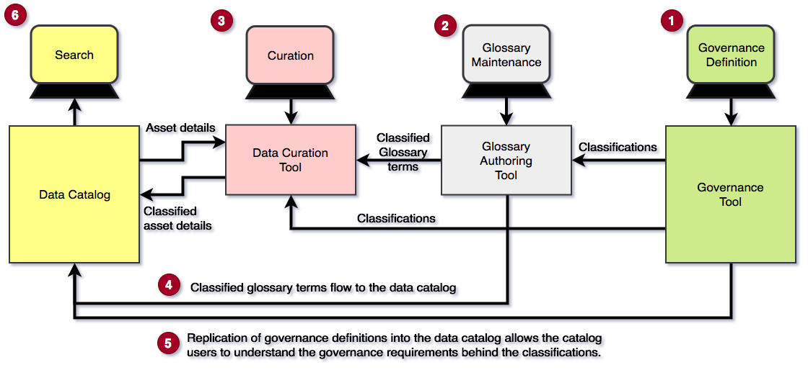
Implementing Governance Awareness

Slide 92
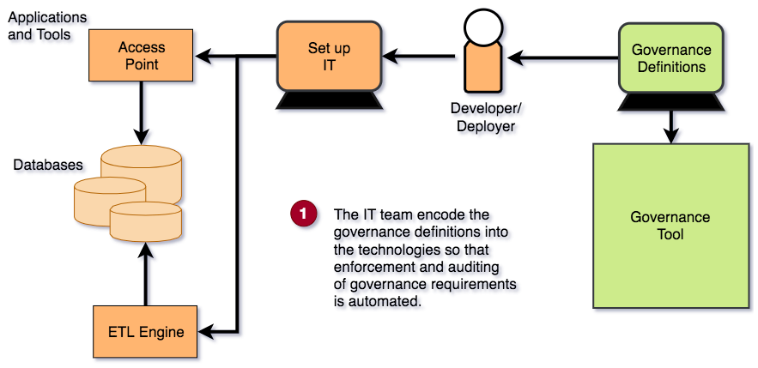
Implementing Embedded Governance

Slide 93
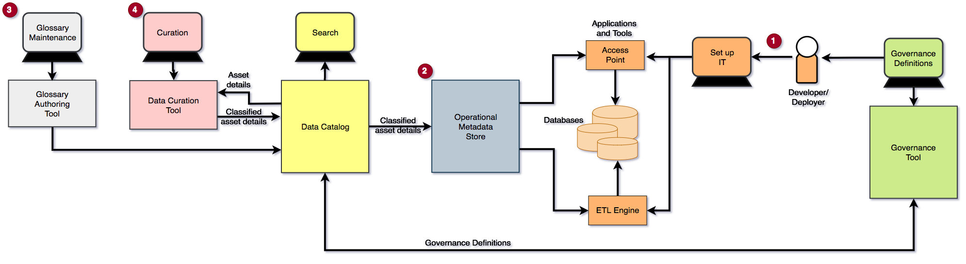
Implementing Business Driven Governance

Slide 94
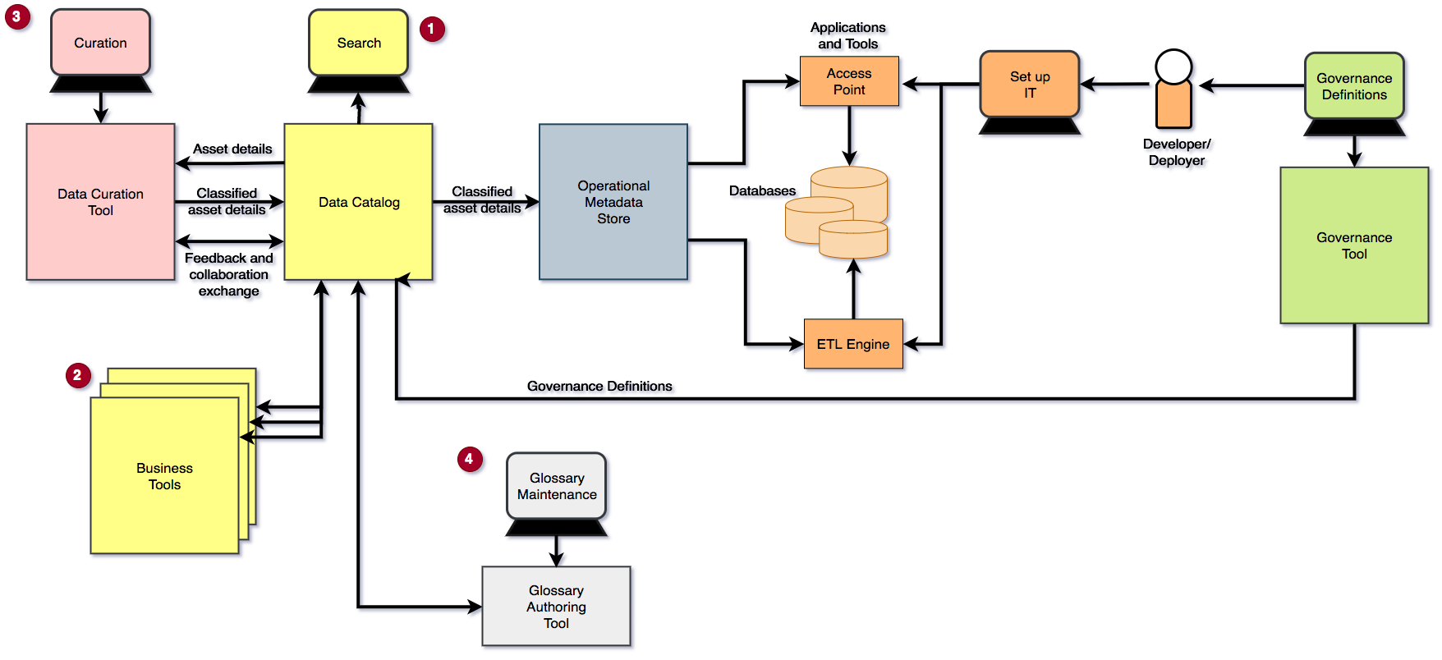
Implementing Data Citizenship

